Slide 1
DrawingBoard PPT Addin
Useful Business Icons Generic

Slide 2
Global Business Icons

Slide 3
Global Business Icons

Slide 4
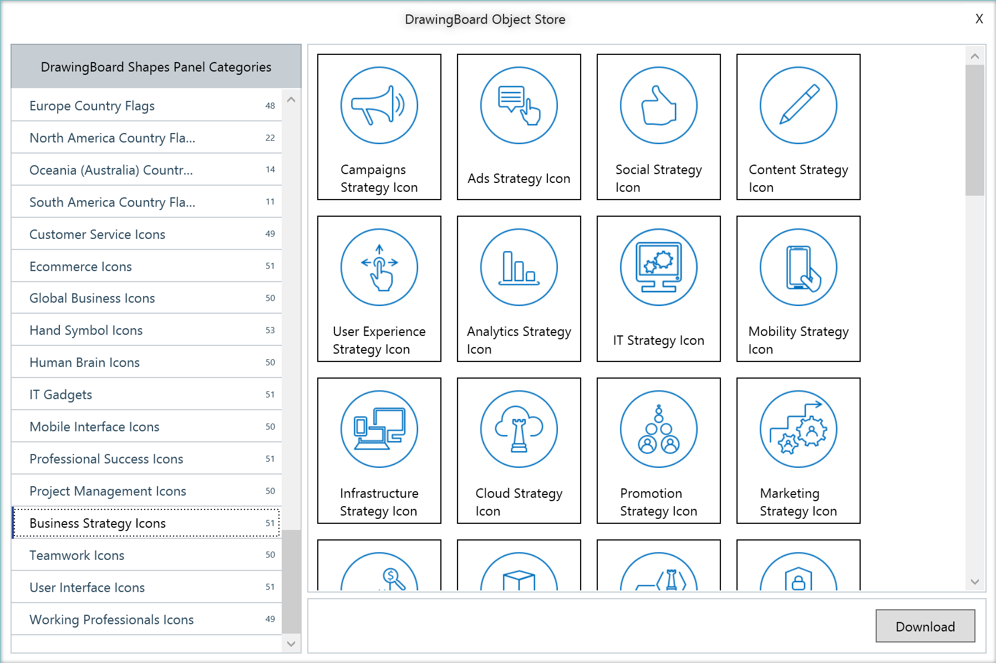
Choose from 100s of categories in Object Store
Dozens of icons related to various aspects of business
Business Strategy Icons
Download in 1 click
Watch Video: https://www.next2office.com/Tutorials.aspx

Slide 5
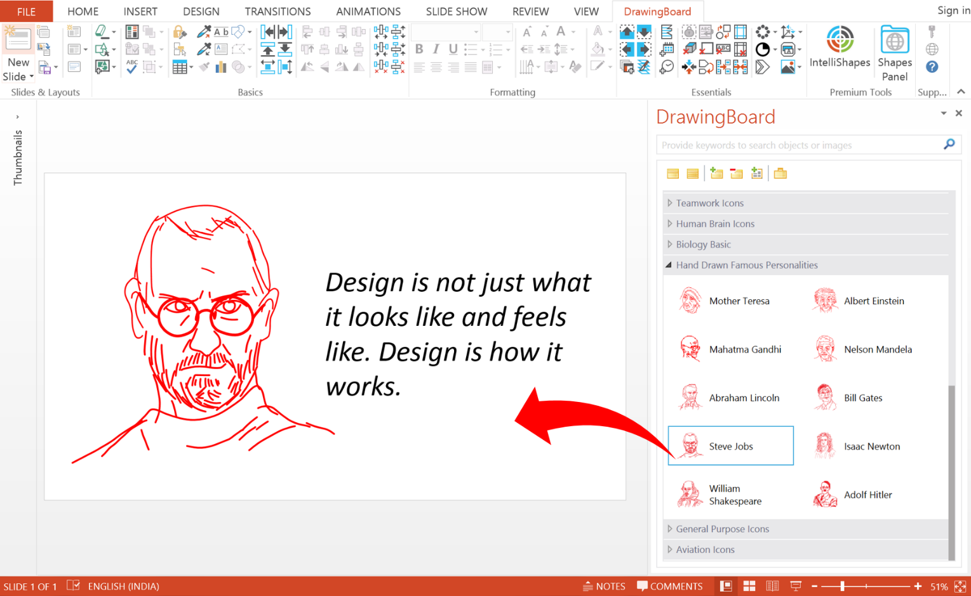
The power of DrawingBoard’s Shapes Panel
Smart Search Feature
Objects organized into category for meaningful classification
Objects displayed as icons with names and description
Drag and Drop action to insert the object into your slide
Watch Video: https://www.next2office.com/Tutorials.aspx

